Slide 1
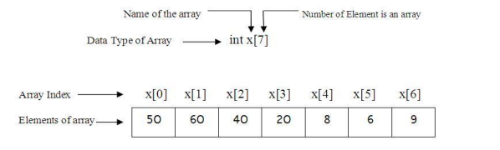
CHAPTER TWO 1.ARRAYS Collection of similar type data elements stored at consecutive locations in the memory.

Slide 2

Arrays dimensions:
A dimension of array is a direction in which you can vary the specification of an array's elements. An array can be of one or many dimensions.
One-dimensional array. Example: a [3] It is an array called a with 3 elements. The elements of the array are logically represented by the name of the array with in brackets its index or positions. For a [3] elements are written like a[0], a[1] and a[2].The indexes start always by 0.
Graphically

Slide 3
Arrays dimensions:…
Two dimensional array
• A Two Dimensional Array is a collection of a fixed number of elements (components) of the same type arranged in two dimensions.
• The two dimensional array is also called a matrix or a table.
• The intersection of a column and a row is called a cell. The numbering of rows and columns starts by 0
Example:• A Two Dimensional Array is a collection of a fixed number of elements (components) of the same type arranged in two dimensions.
• The two dimensional array is also called a matrix or a table.
• The intersection of a column and a row is called a cell. The numbering of rows and columns starts by 0 Example:

Slide 4
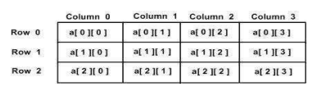
Arrays dimensions:…
Two dimensional array Example: The array a[3][4] is an array of 3 rows and 4 columns. In matrix representation, it looks like the following
NB: Each element is identified by its row and column

Slide 5
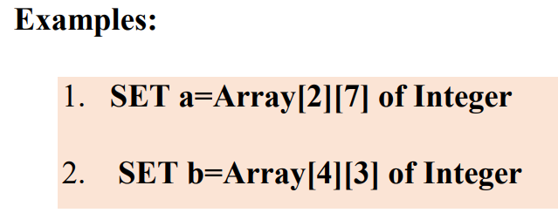
Two dimensional array declaration
The syntax for declaring a two-dimensional array is:
Where row size and column size are expressions yielding positive integer values, the two expressions row size and column size specify the number of rows and the number of columns, respectively, in the array.
Notice that the number of elements =row size*column size

Slide 6
Examples
The examples above defines respectively arrays named a and b with 14 (2*7) elements and 12 (4*3) elements. The expression marks [0] [0] will access the first element of the matrix marks and marks [1] [6] will access the last row and last column of array a.

Slide 7
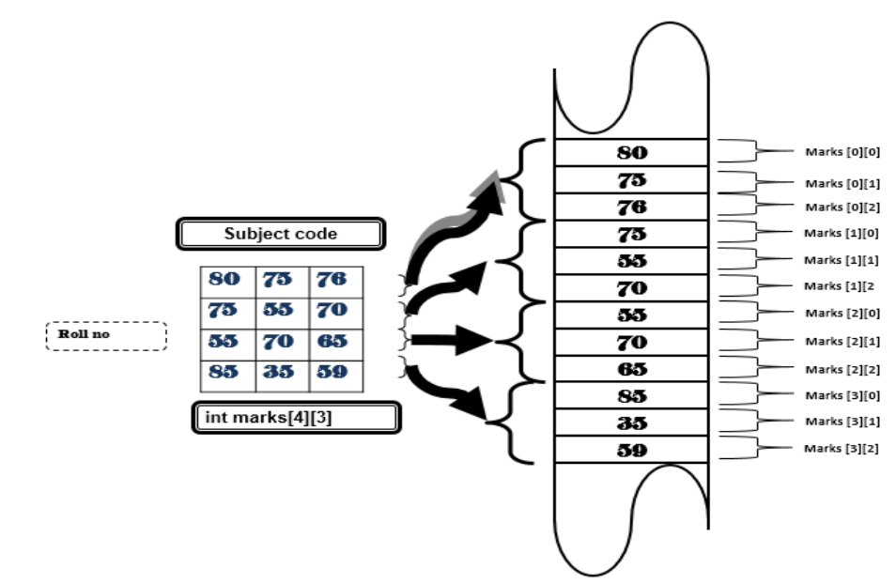

Slide 8
Two dimensional array initialization
When a two-dimension array has been declared, it needs to be assigned values for its elements. This action of assigning values to array elements is called initialization.
Two-Dimensional array is initialized by specifying bracketed values for each row. For the case of an array of 3 rows and 4 columns, if the name is A and the type of elements is integer, the initialization is:

Slide 9
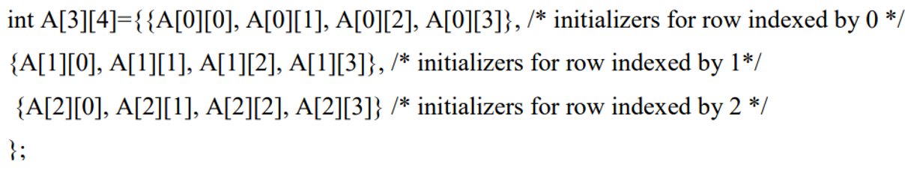
The nested braces, which indicate the intended row, are optional. The following initialization is equivalent to the previous initialization.

Slide 10
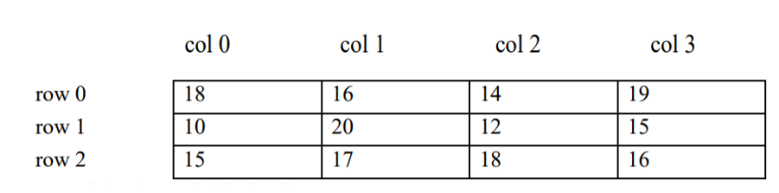
An example of marks for 3 students in 4 courses. The array will look like this:
If the table is called marks, marks [1][3]=15; where the row position is 1 and the column position is 3. The expression marks [0] [0] will access the first element of the matrix marks and marks [2] [3] will access the last row and last column.

Slide 11
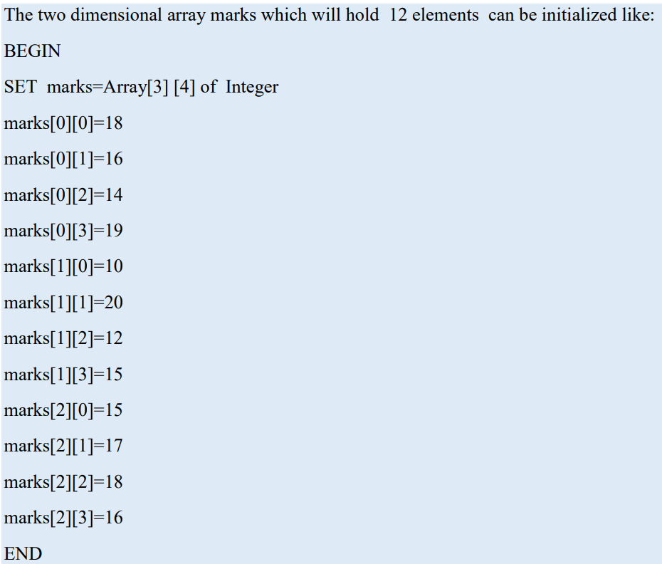
Syntax to initializing two-dimensional arrays

Slide 12
Class work
5 universities in Kigali are displaying the number of students per year that they registered in 2021, 2022, 2023 and 2024.
How many rows and columns will be in the table that contains the displayed data?
Declare an array called population to contain the needed data.
Initialize the array population with numbers of your choice.

Slide 13
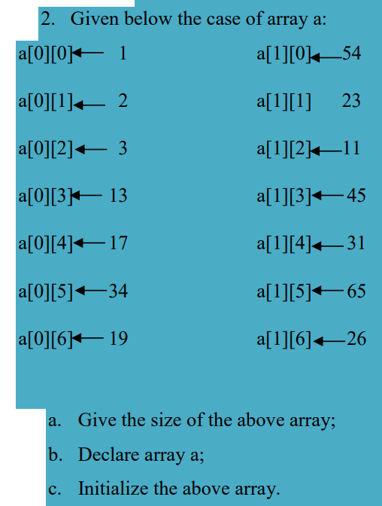
Class work …

Slide 14
Accessing two dimensional array elements
Reading (storing) two dimensional array elements
There exist two ways of accessing the elements of an array. The elements’ values of the array can come from the input devices or from a given file so that these elements are written into the array.
The function used is READ or other versions of it, depending on the programming languages used for programs writing.
For example READ marks[1][2] stores a value in second row, third column location of the array marks.

Slide 15
Reading (storing) two dimensional array elements…
Example: Write an algorithm of a program that allows the user to enter (store) two dimensional array elements.
BEGIN
SET marks=Array [3] [8] of Integer
Use variable i as integer
Use variable j as integer
FOR i=0 TO 2 DO
FOR j=0 TO 7 DO
READ marks[i] [j]
END FOR
END FOR
END

Slide 16

Writing (displaying) two dimensional array elements
To access two dimensional array elements’ values, we can also take the elements’ values of an array residing in the memory of the computer and write them in any output device or a given file. To write (display) elements from an array in an output device or other file, use a WRITE function or other versions of it depending on the programming languages used for programs writing together with the array name and location (index) of the element.
Syntax:
Where i refers to the row position and j refers to the column position.

Slide 17
Writing (displaying) two dimensional array elements
To display a single value of an array you must provide the array name and index to write operation example:
Example for writing on screen a two dimensional array element WRITE a[1][2], i=1 and j=2).
Example: Write an algorithm of a program that displays stored two dimensional array marks’ elements

Slide 18
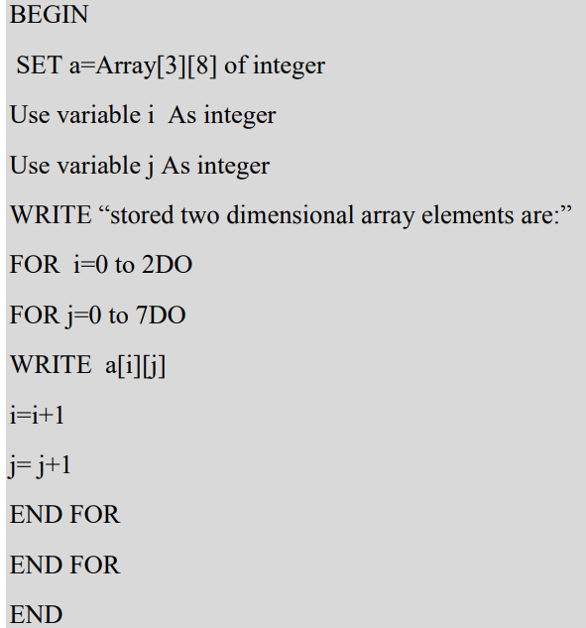
Example …

Slide 19
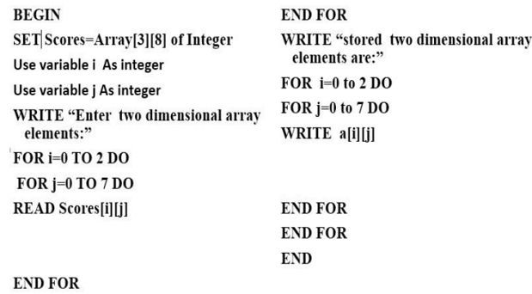
Algorithm for reading and printing values in arrays
Example: Write an algorithm that allows the user to enter(store) two dimensional array elements and displays those stored elements.

Slide 20
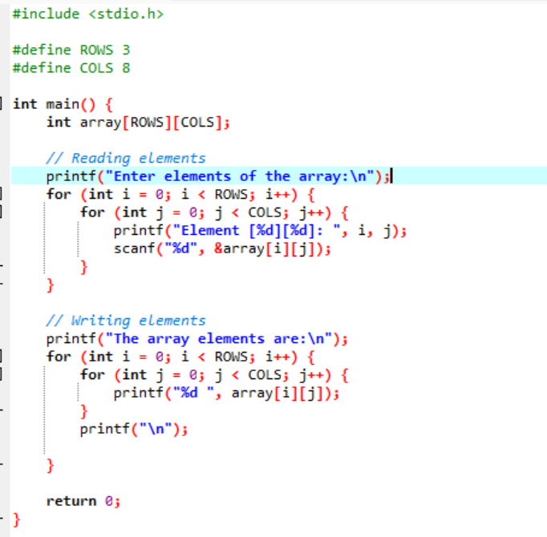
Read and write implementation in c language

Slide 21
Operations on Array
Insertion
Deletion
Merge
Traversal
Find

Slide 22
Insertion Operation on Array
It is the process of adding an element into the existing array. It can be done at any position.
Insertion at the end is easy as it is done by shifting one position towards right of last element if it does not exceeds the array size

Slide 23
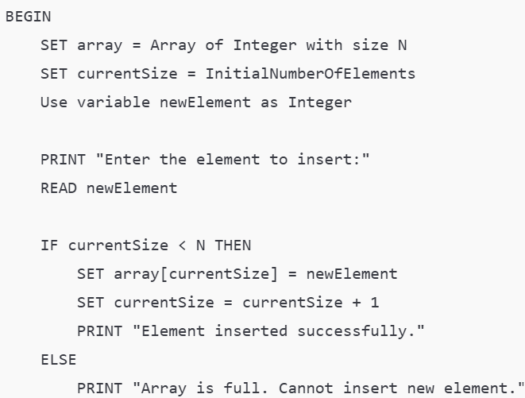

Insert Element at the End of a Pre-Filled Array

Slide 24
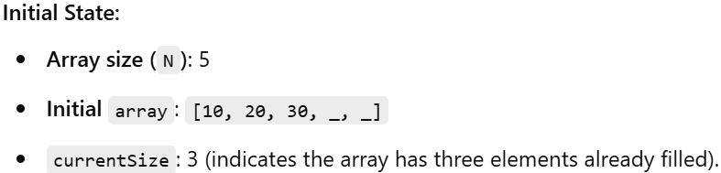
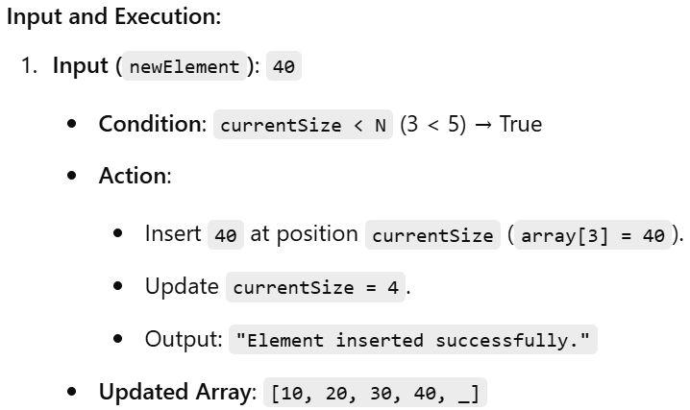
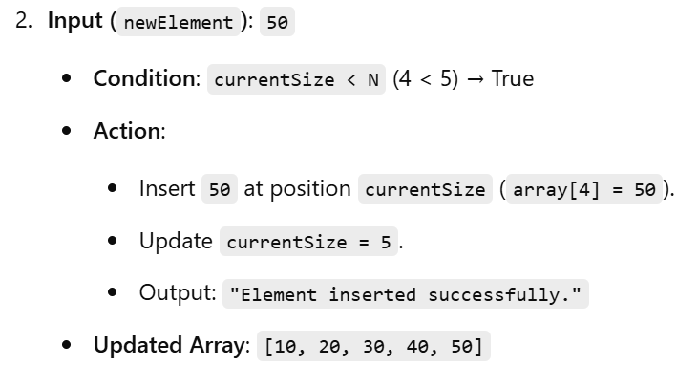
Example Execution:

Slide 25
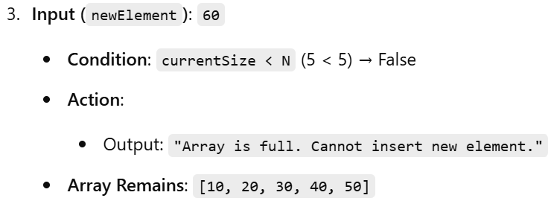
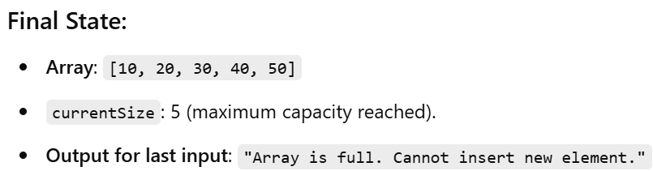
Cont’d

Slide 26
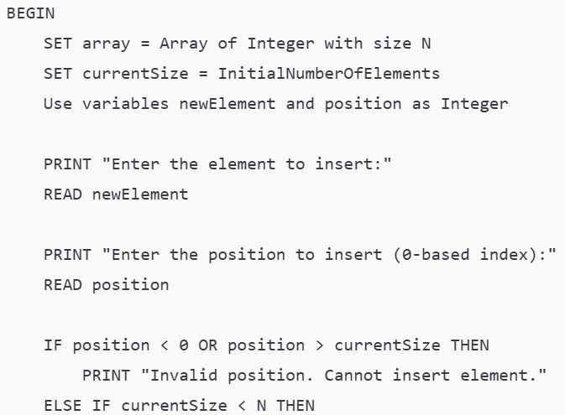
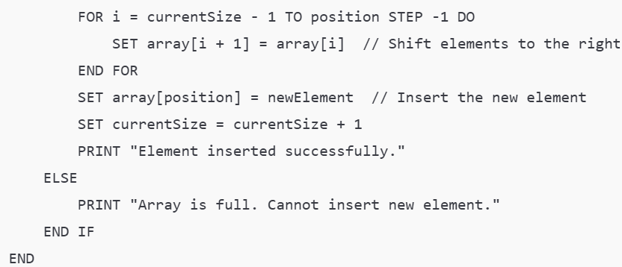
Pseudocode: Insert Element at a Specified Position

Slide 27
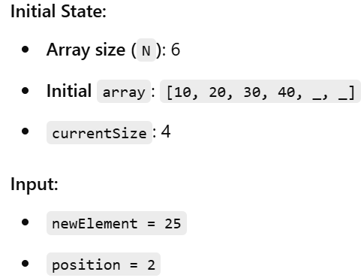
Example Execution:

Slide 28
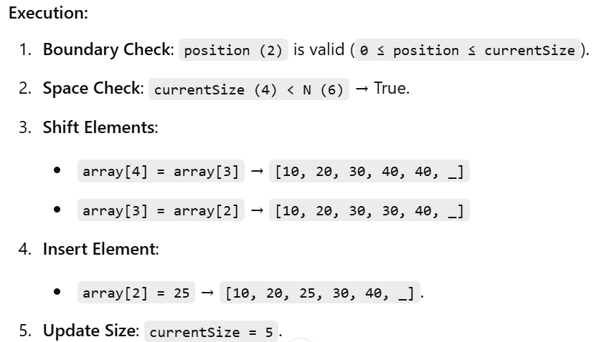
Cont’d

Slide 29
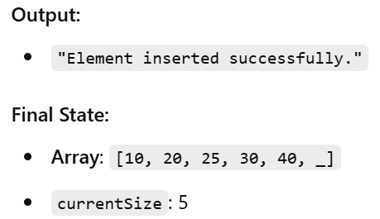
Cont’d

Slide 30
END

